Slide 1



DevinfraX
Automated Hybrid Infrastructure
Group No. 4

Slide 2
INTRODUCTION
End-to-End CI/CD Automation using DevOps Tools
DevOps-based automated deployment project
Focuses on quality, security, performance, and monitoring
Implemented using a hybrid infrastructure

Slide 3
Problem Statement
Manual deployments are often slow and error-prone, increasing the risk of mistakes during releases. The absence of proper testing before moving changes to production further amplifies the chances of failures and unstable applications. Additionally, without continuous monitoring after deployment, issues may go unnoticed, leading to performance degradation, downtime, and a poor user experience.

Slide 4
OBJECTIVES
Automate CI/CD pipeline
Ensure quality, security, and performance
Deploy reliably on hybrid infrastructure

Slide 5
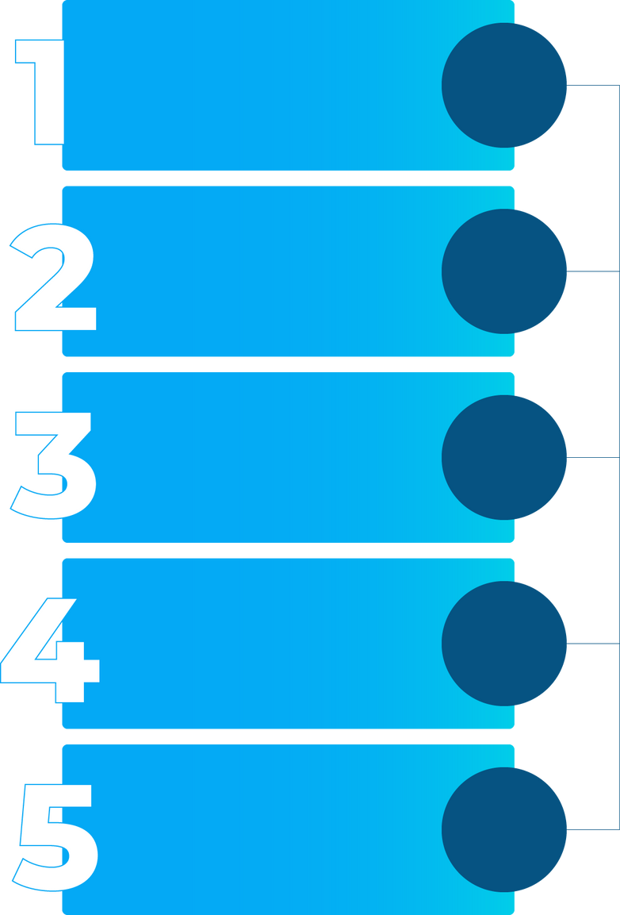
Hybrid Infrstructure Architecture
Control
Stage
Pre-Prod
Production

Slide 6
CI/CD Workflow
Developer pushes code to GitHub
Jenkins builds application & Docker image
Image pushed to Docker Hub
Stage testing (quality & security)
Pre-Prod testing (performance)
Production deployment
Continuous monitoring

Slide 7
CONCLUSION
DevinfraX demonstrates real-world DevOps practices by integrating industry-standard tools and workflows, ensuring reliable and scalable deployments. It also covers the full application lifecycle, from development and testing to deployment and ongoing operations, making it a comprehensive and practical DevOps solution.

Slide 8
FUTURE SCOPE
Kubernetes integration
Auto-scaling and logging
Advanced alerting mechanisms

Slide 9
THANK YOU

